Slide 1

AI-POWERED MENTAL HEALTH & WELL-BEING ASSISTANT
ENHANCING WORK-LIFE BALANCE THROUGH AI & CHATBOTS
Team : NaN

Slide 2
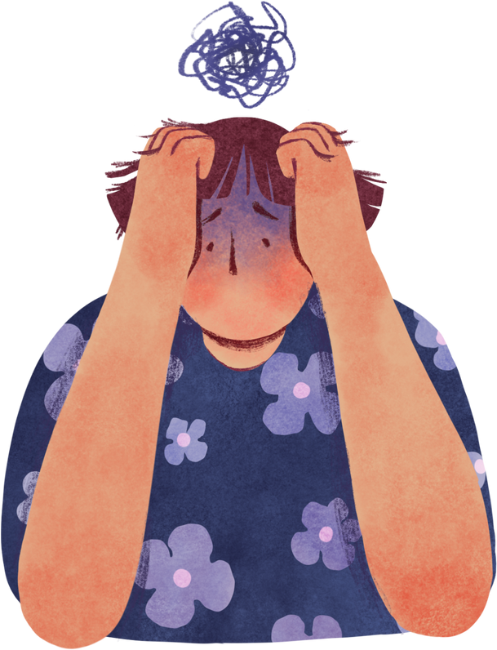
THE PROBLEM
Why Mental Well-being Matters
Many people experience work stress, social disengagement, and burnout.
Lack of proper assessment leads to poor mental health awareness.
Need an automated, data-driven solution for well-being analysis.

Slide 3

OUR SOLUTION
AI-powered well-being assistant
Cognitive Overload
Social Engagement Needs
Work-Life Balance Issues
Uses Machine Learning (XGBoost, Random Forest, Logistic Regression).

Slide 4

KEY FEATURES
Data-Driven Mental Health Assessment
ML-Based Predictions – Implements XGBoost, Random Forest, and Logistic Regression, with XGBoost as the most accurate.
Personalized Insights and recommendations.
Interactive UI
Flask Backend
AI Chatbot Support
Scalable & Future-Ready – Potential for real-time monitoring and chatbot integration.

Slide 5
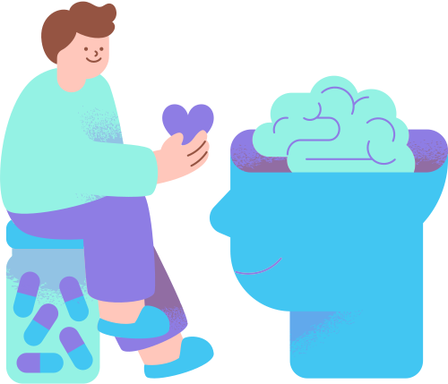
DATASET & PREPROCESSING
Dataset: Kaggle Well-being & Lifestyle Data
Key steps in preprocessing:
Removal of irrelevant features (e.g., timestamps)
Handling missing values with mode/median
Encoding categorical features
Outlier removal using IQR method
Feature scaling with StandardScaler

Slide 6
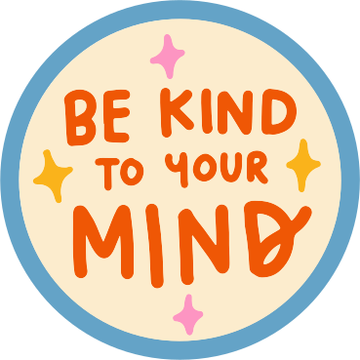
HOW DOES IT WORK?
"Access to free psychological help"
AI analyzes your responses (Social, Work, Self-care, Stress)
Machine Learning predicts cognitive overload & engagement needs
Reinforcement Learning optimizes time management
AI Chatbot offers mental health support

Slide 7

FEATURE ENGINEERING
New meaningful features created:
Social Activity Score = PLACES_VISITED + SOCIAL_NETWORK + SUPPORTING_OTHERS
Work Productivity Score = ACHIEVEMENT + TODO_COMPLETED + PERSONAL_AWARDS
Self-Care Score = SLEEP_HOURS + TIME_FOR_PASSION + WEEKLY_MEDITATION
Target variables:
Cognitive Overload (1 if stress is high, else 0)
Social Engagement Needs (1 if social interaction is low, else 0)
Work-Life Balance Issues (1 if balance is poor, else 0)

Slide 8
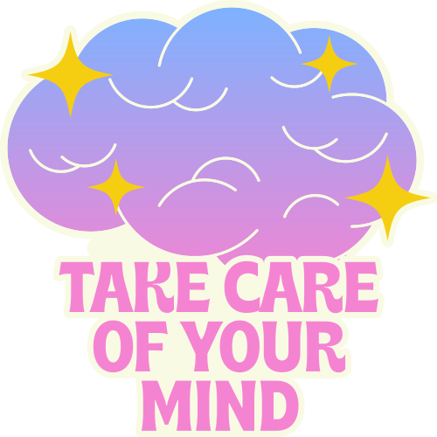
MODEL TRAINING & EVALUATION
Train-Test Split: 80% training, 20% testing
Performance Metrics:
Accuracy
Precision, Recall, F1-score
Best Model: XGBoost (highest accuracy)

Slide 9

MINDEASE CHATBOT
Core Functions
Emotional Support
Self-Help Strategies
Crisis Intervention
Moderation Rules –
Filters out harmful, violent, or inappropriate discussions.
Deployment & Accessibility
Integrated via Jotform for easy access.
Embedding code allows seamless deployment on websites.
User-friendly, with real-time engagement options.
Content Moderation
No promotion of self-harm, violence, or misinformation.
Encourages respectful and inclusive conversations.
Redirects users to trusted sources when necessary.

Slide 10
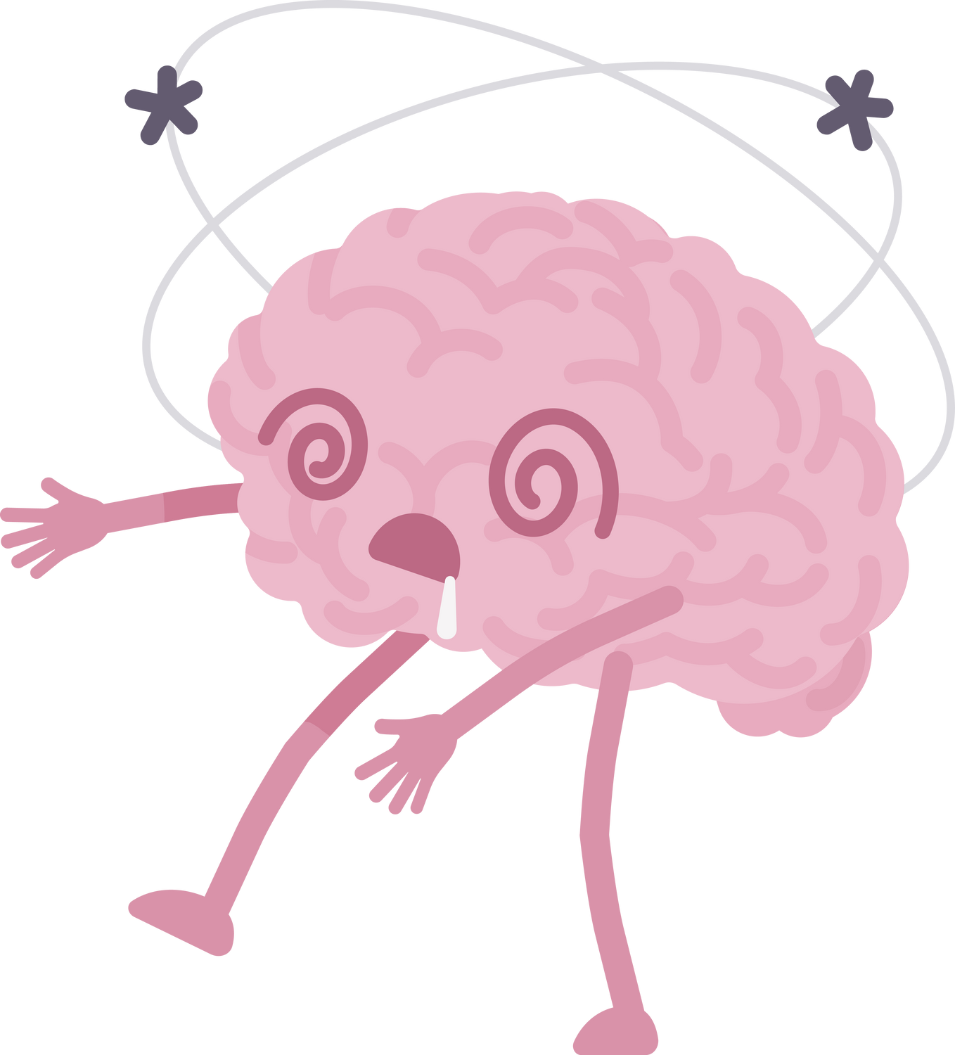
RESULTS & DISCUSSIONS
"Anxiety is a real problem in our society"
Example: Daily Scores (Social Activity Score: 57, Work Productivity Score: 83, Self Care Score: 53, Stress Impact Score: 71)
AI Suggests:
“Schedule regular catch up with friends and colleagues”
“Join community groups or social activities”
“Engage more in team activities at work”

Slide 11
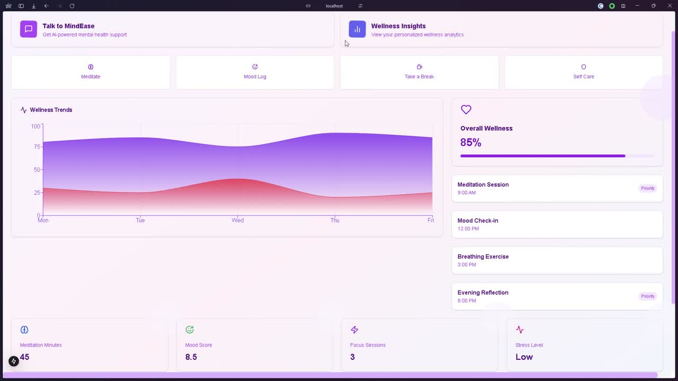
DEMONSTRATION AND WORKING

Slide 12

FUTURE ROADMAP
Smart Calendar Sync (Stress-based Rescheduling)
Chatbot on WhatsApp, Telegram, Slack
Gamification (Rewards for Well-being Tracking)
Wearable Integration (Apple Watch, Fitbit)

Slide 13

CONCLUSION
Empowering Users with AI & Mental Health Support
Making work-life balance stress-free with AI-driven insights

Slide 14

THANK YOU

